Slide 1



Customer Churn Prediction using Machine Learning
BY: NITHYA SANTHOSHINI K
BATCH: 263

Slide 2


ABOUT ME
BACKGROUND:
I am a recent B.Tech graduate in Computer Science with a strong interest in data analytics, software development, and cloud engineering.
WORK EXPERIENCE:
Currently, I am gaining practical exposure at Innomatics Research Labs, where I am working on various data science and Deep Learning projects.
CAREER GOALS:
I am eager to further my career in Data Science and make meaningful contributions by leveraging my analytical skills, technical knowledge, and passion for solving complex problems.

Slide 3


Overview
Introduction
1
Objective
2
Dataset Overview
3
Exploratory Data Analysis (EDA)
5
Model Building
10
Data Preprocessing
11
Model Comparison & Selection
13
Hyperparameter Tuning & K - Fold Validation
19
Conclusion
22

Slide 4

Introduction
Predicting Customer Churn:
Churn prediction means detecting which customers are likely to leave a service or to cancel a subscription to a service.
It is a critical prediction for many businesses because acquiring new clients often costs more than retaining existing ones.
1

Slide 5

OBJECTIVE
Goal: The primary goal of this project is to predict customer churn in the telecom industry.
Purpose: By identifying customers who are likely to churn, telecom companies can take proactive measures to retain them and reduce customer attrition.
Impact: Understanding the factors that lead to churn allows businesses to implement targeted retention strategies, improve customer satisfaction, and enhance overall profitability.
In essence, this project aims to leverage data-driven insights to help companies maintain their customer base and minimize the negative impacts associated with high churn rates.
2

Slide 6
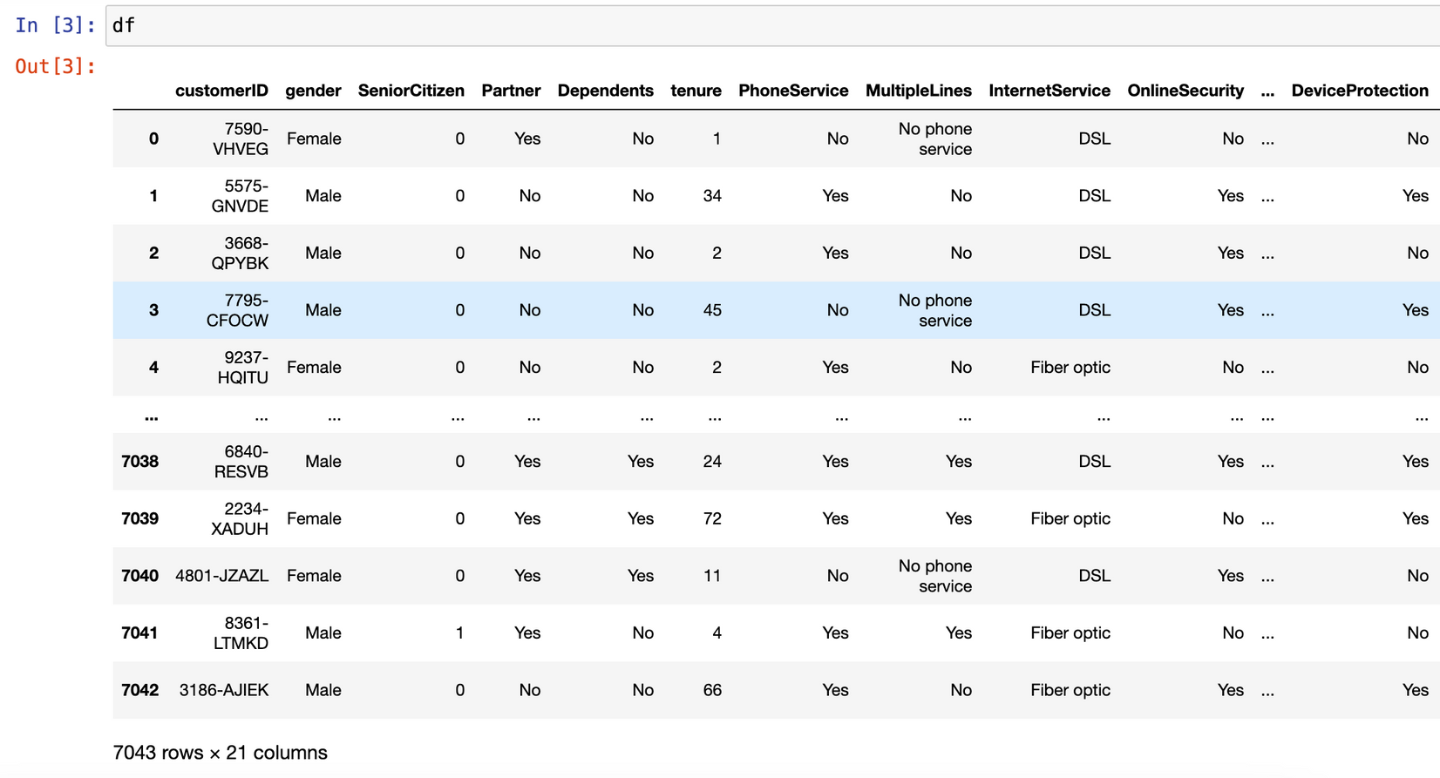
DATASET OVERVIEW
Dataset Source
Platform: Kaggle
Size: Contains approximately 7,043 rows and 21 columns of churn data.
Key Features
Explanatory Variables: 21 variables that describe various aspects of customer behavior and service usage. These include demographic details, service information, and billing details.
Target Variable: Churn (Whether the customer has churned, Yes/No)
3

Slide 7
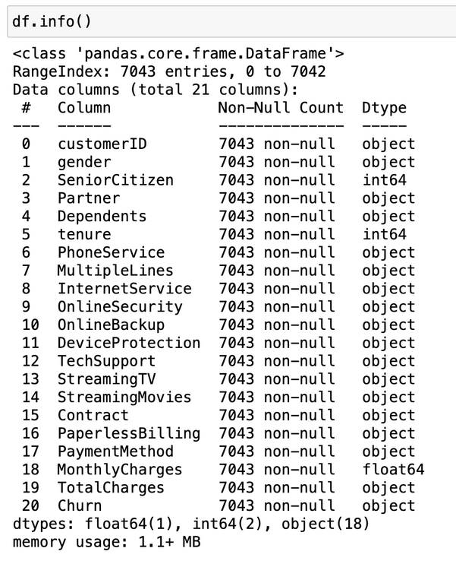
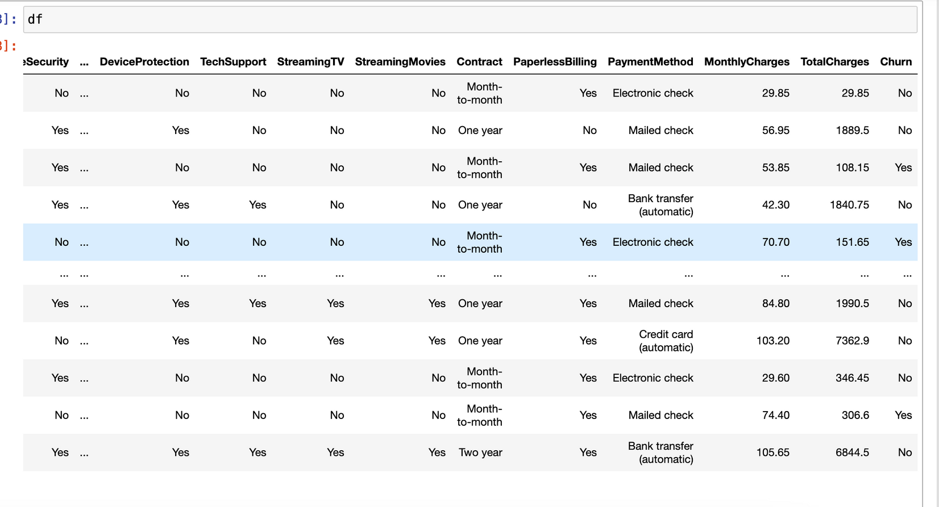
DATASET OVERVIEW
Objective
Prediction Task: Using classification techniques to predict whether a customer will churn.
Purpose: To apply machine learning algorithms to understand the factors leading to churn and to make accurate predictions for customer retention.
This dataset offers a rich set of features for analyzing customer churn, making it suitable for developing and evaluating predictive models.
4

Slide 8
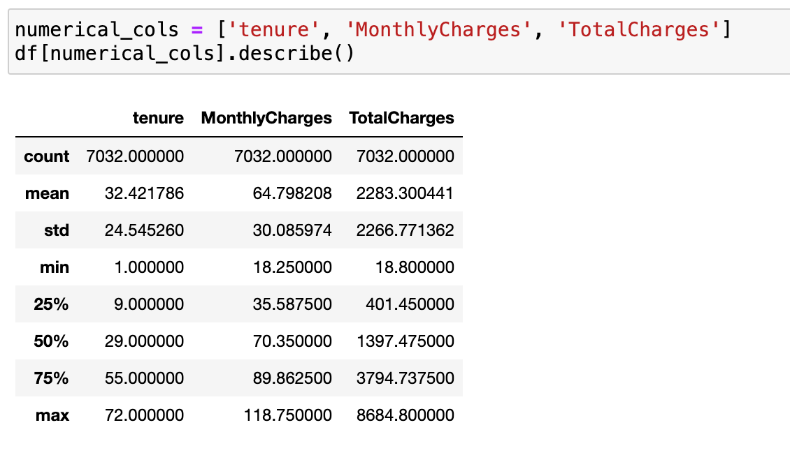
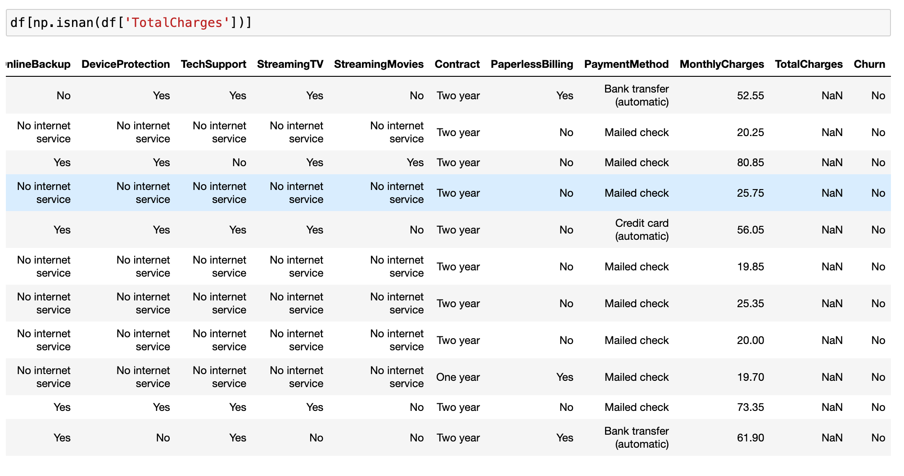
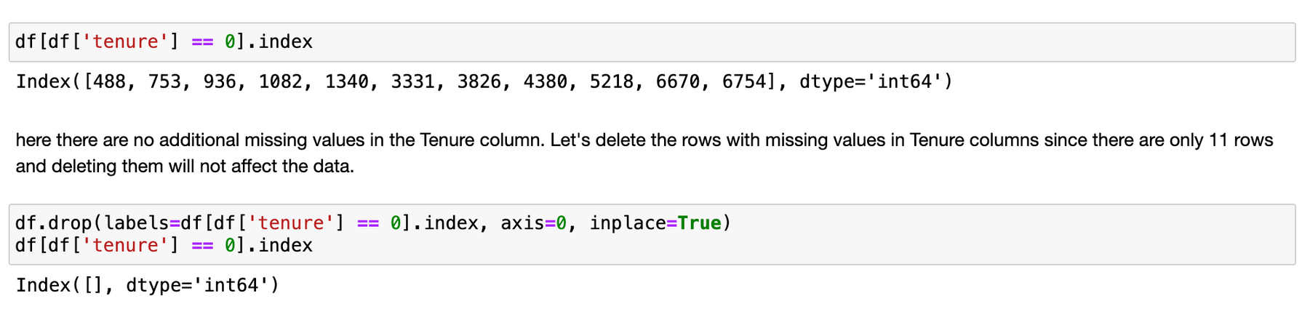
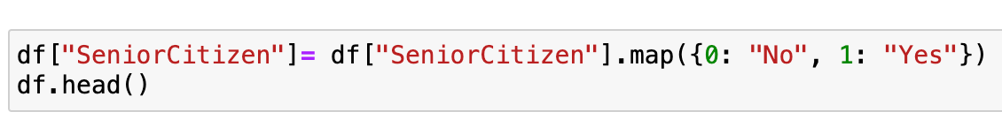
EXPLORATORY DATA ANALYSIS
Data Overview
Initial Inspection: Load the dataset and display the first few rows to understand its structure.
Generated descriptive statistics to get a sense of the data distribution (mean, median, standard deviation, etc.).
Data Cleaning:
Handling Missing Values: Identified and handled any missing values in the dataset.
Correcting Data Types: Ensured all columns have appropriate data types.
5

Slide 9
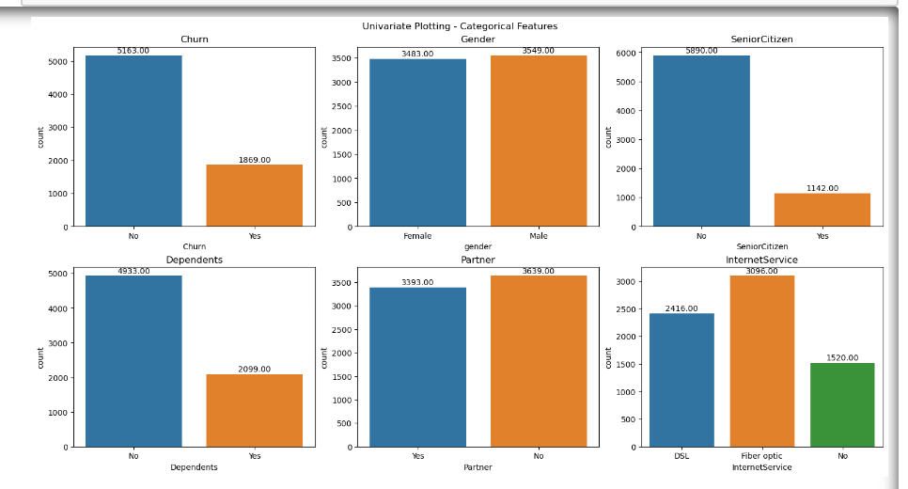
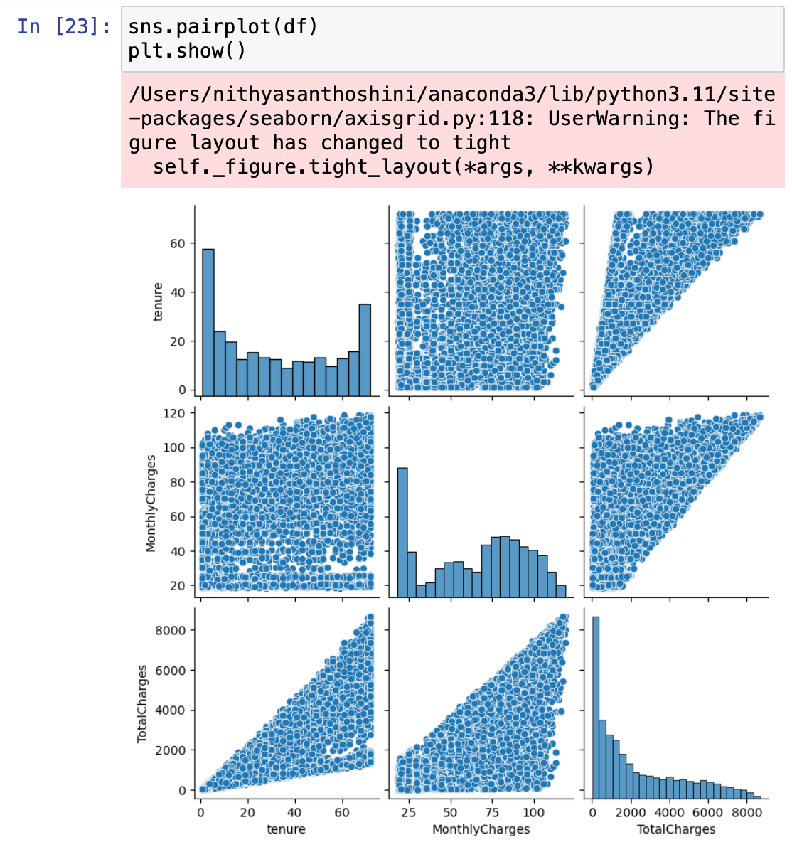
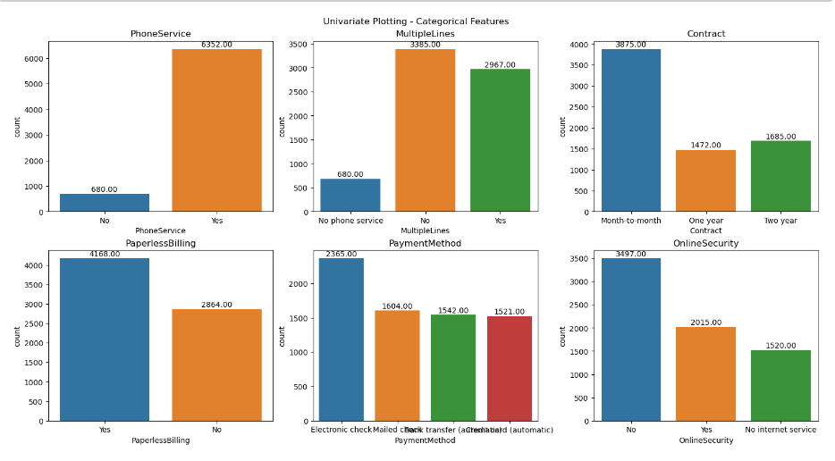
DATA VISUALIZATIONS
UNIVARIATE ANALYSIS
6

Slide 10
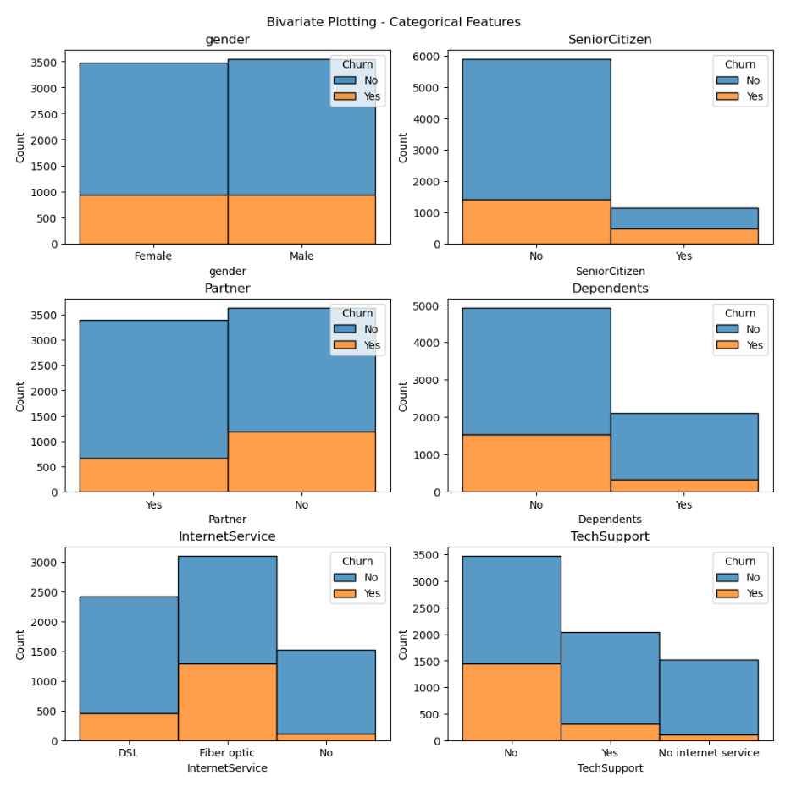
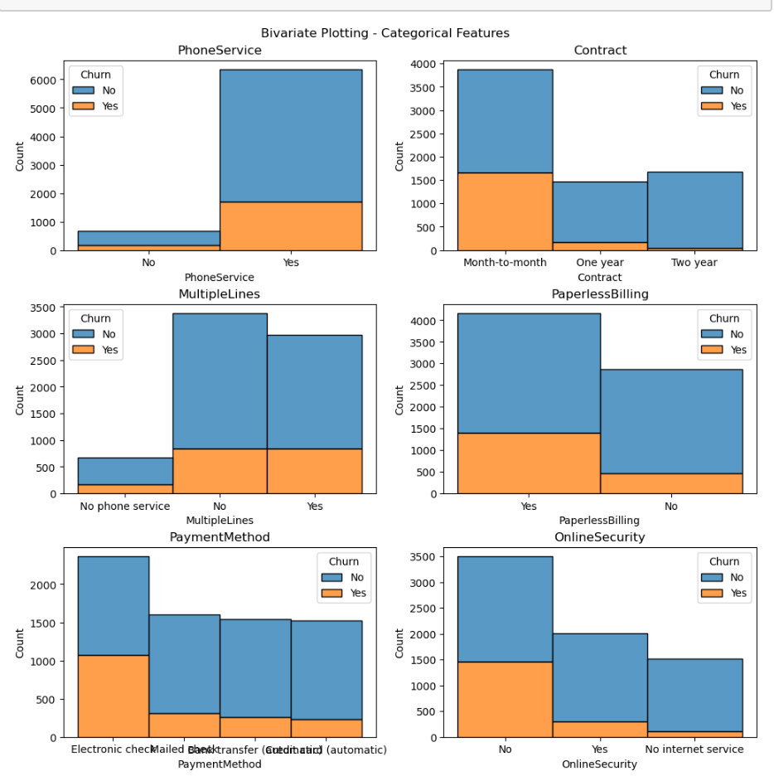
Bivariate analysis
7

Slide 11
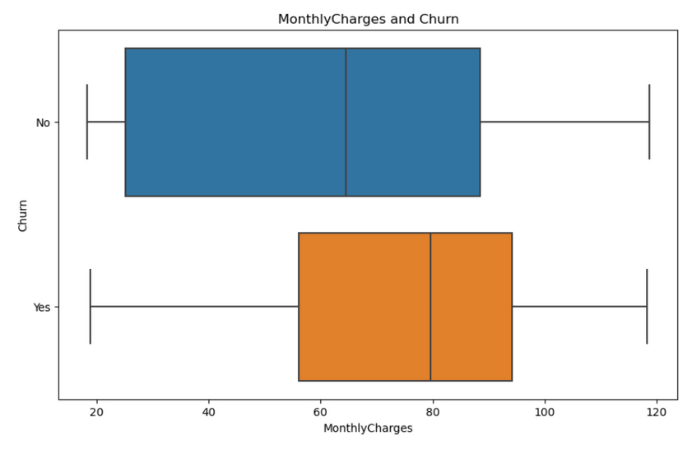
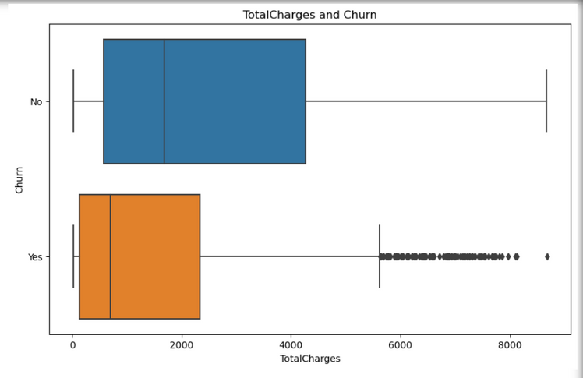
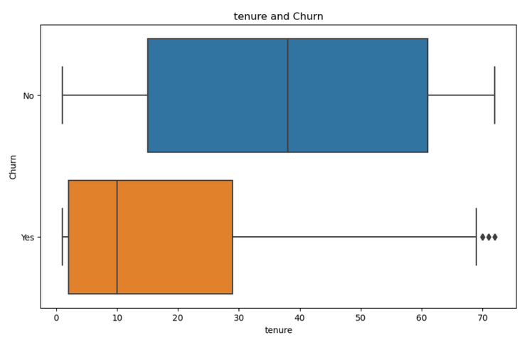
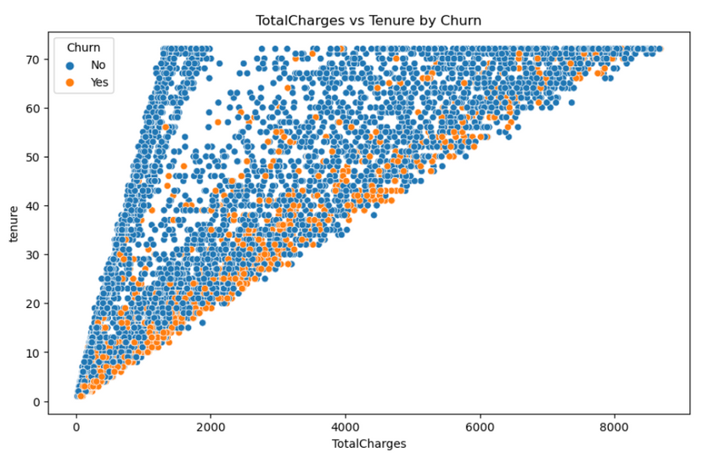
Bivariate & Multivariate analysis
8

Slide 12
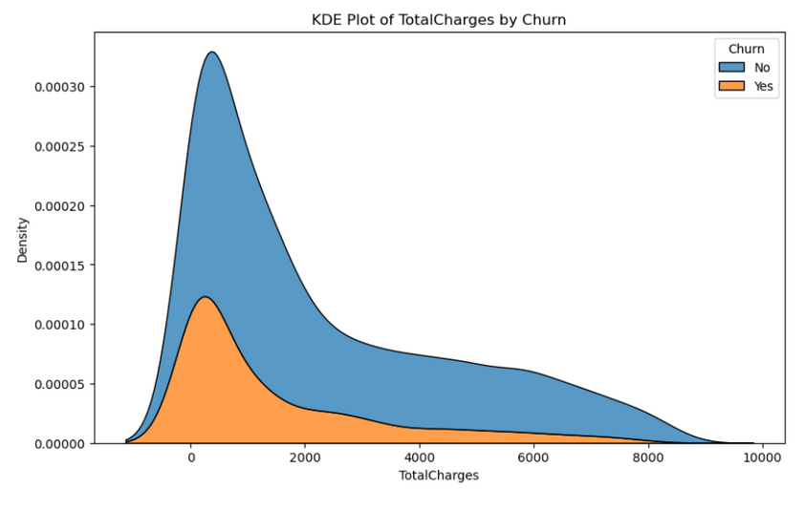
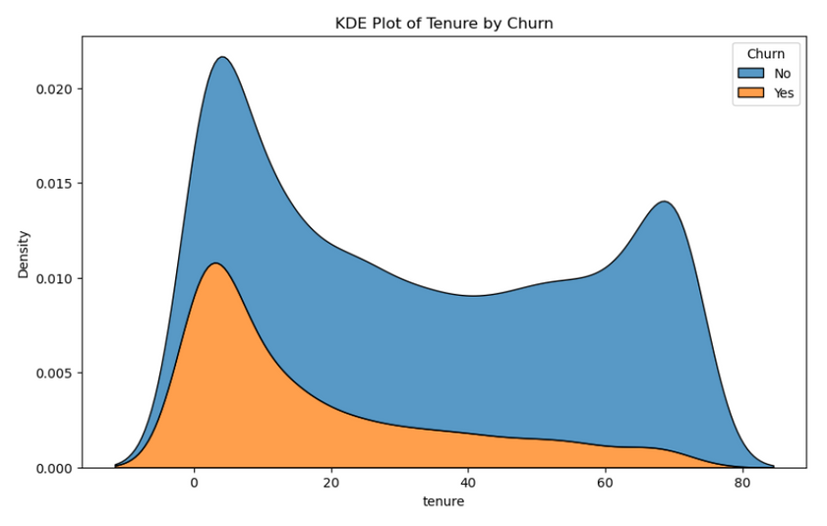
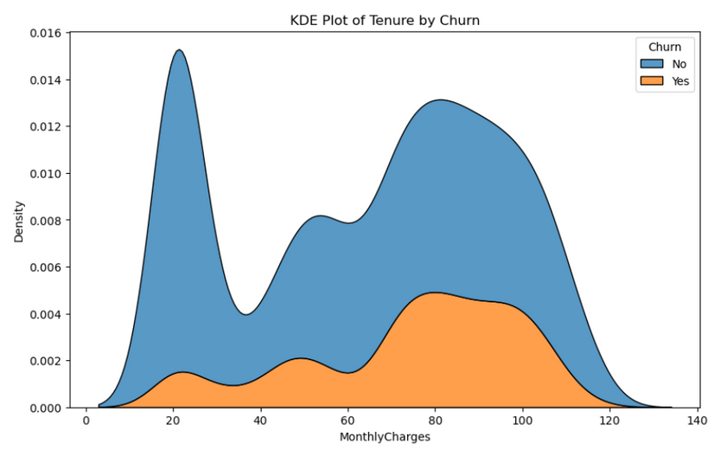
DATA VISUALIZATIONS
9

Slide 13

Data Preparation: Preparing the dataset by handling missing values, encoding categorical features, and standardizing numerical features.
Ensured all features were appropriately formatted and ready for model input.
01
Model Building
Model Selection: Evaluating multiple models to identify the best one for predicting churn.
Considered various algorithms including Logistic Regression, Decision Tree, Random Forest, and Support Vector Machine.
02
Introduction
In this section, we will walk through the process of building and evaluating different models to predict customer churn.
Training and Validation: Splitting the dataset into training and testing sets to train the models and validate their performance.
Used cross-validation techniques to ensure robustness and avoid overfitting.
03
Model Evaluation: Comparing models using key metrics such as Accuracy, Precision, Recall, and F1 Score.
Selected the Random Forest Classifier as the best-performing model based on these metrics.
04
10

Slide 14
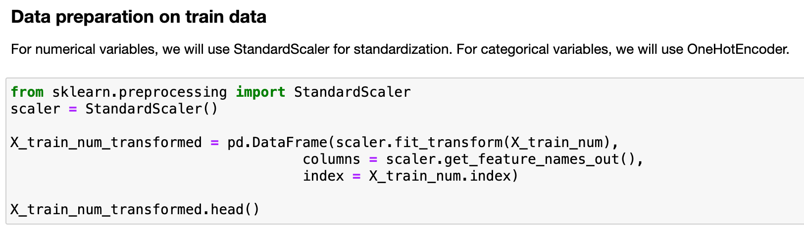
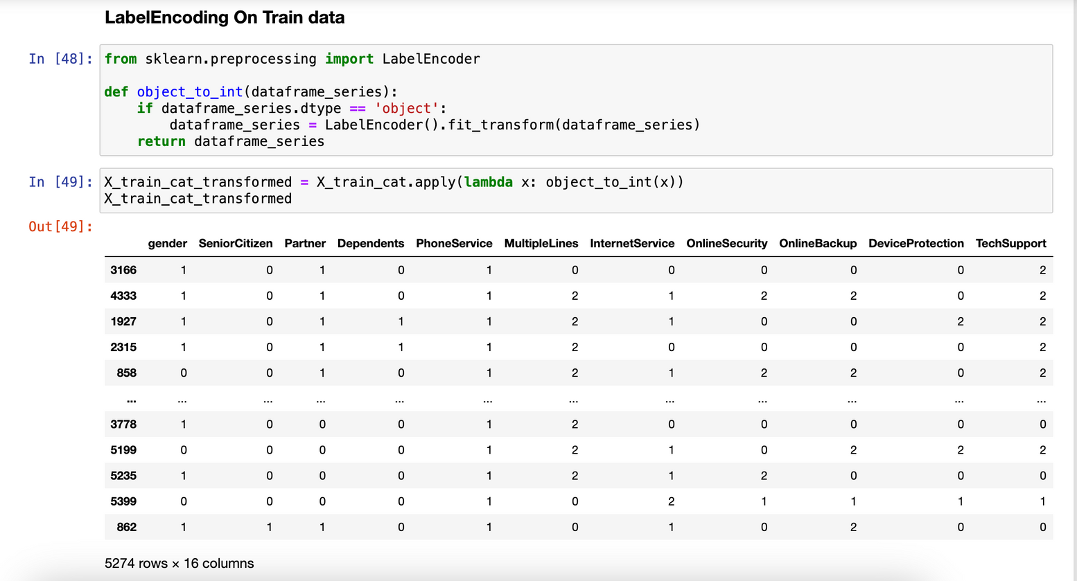
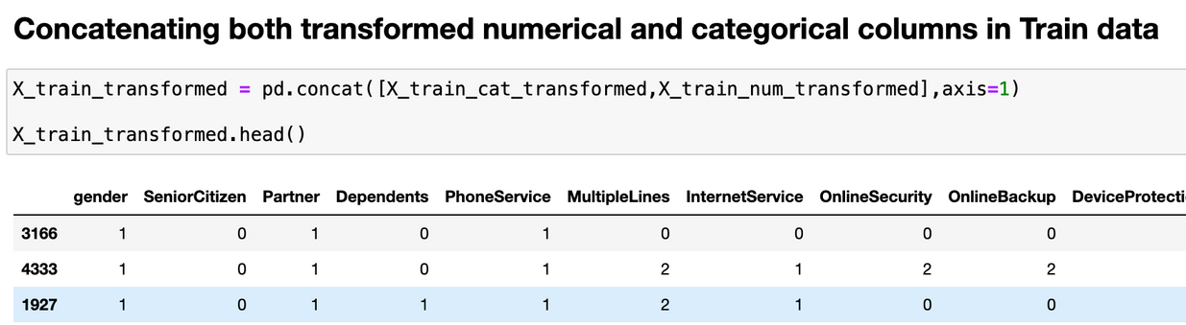
DATA PREPROCESSING
11

Slide 15
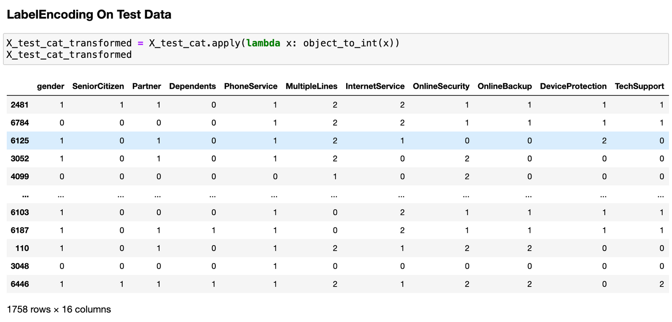
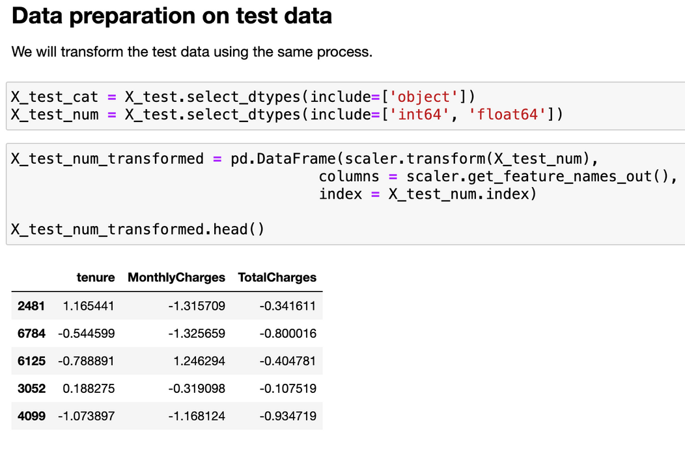
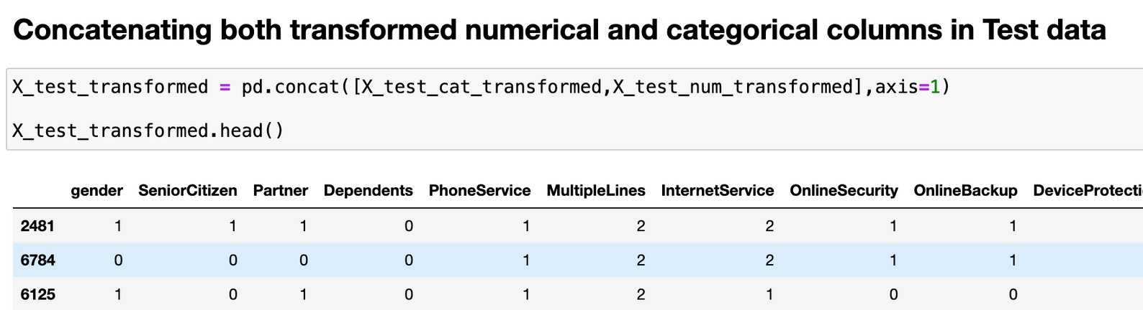
DATA PREPROCESSING
12

Slide 16
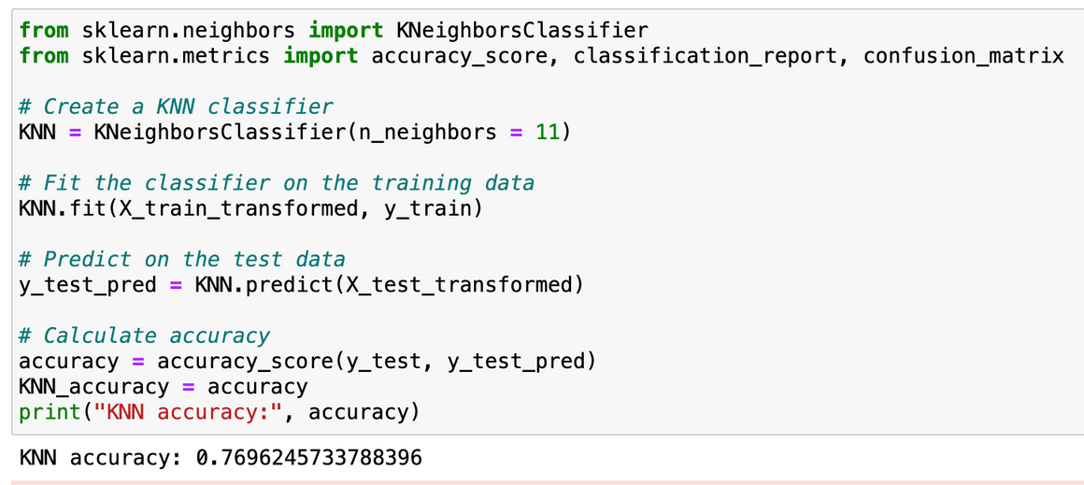
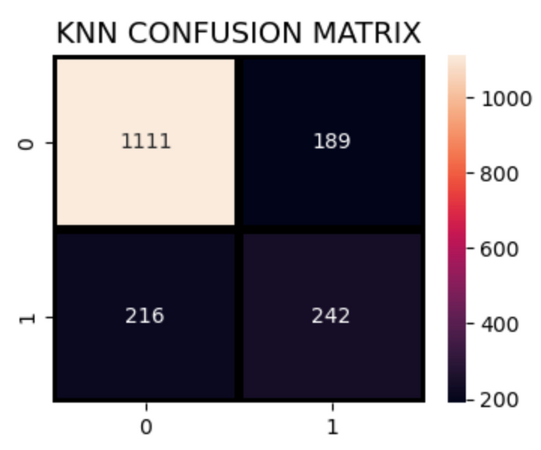
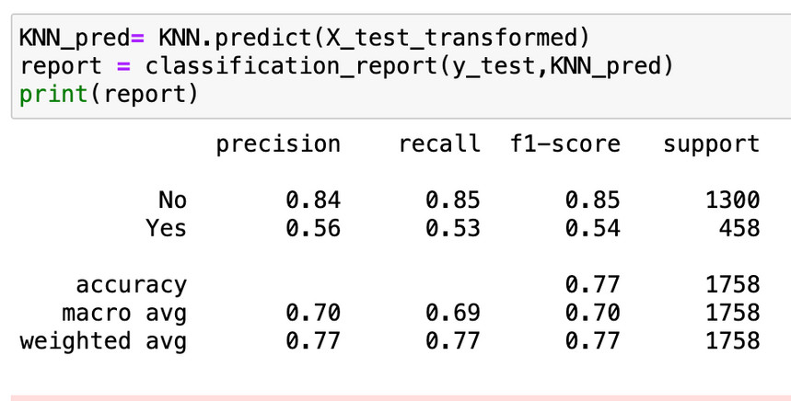
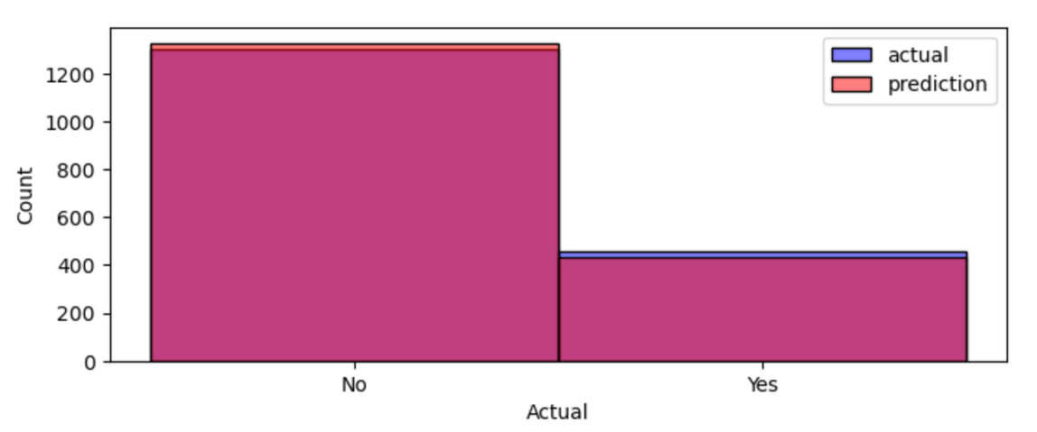
K - NEAREST NEIGHBOURS
13

Slide 17
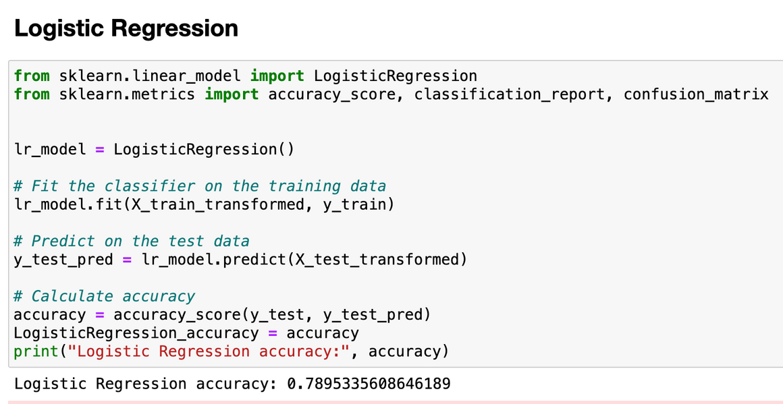
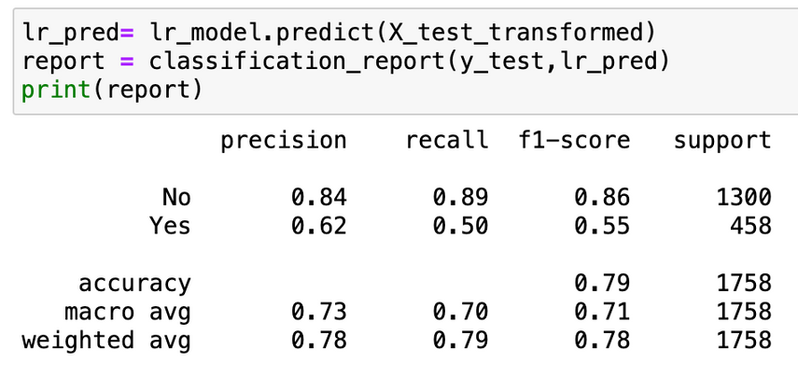
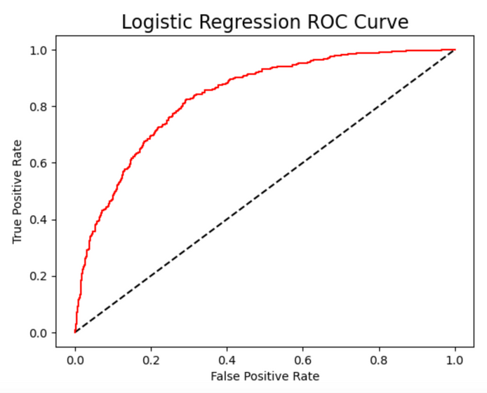
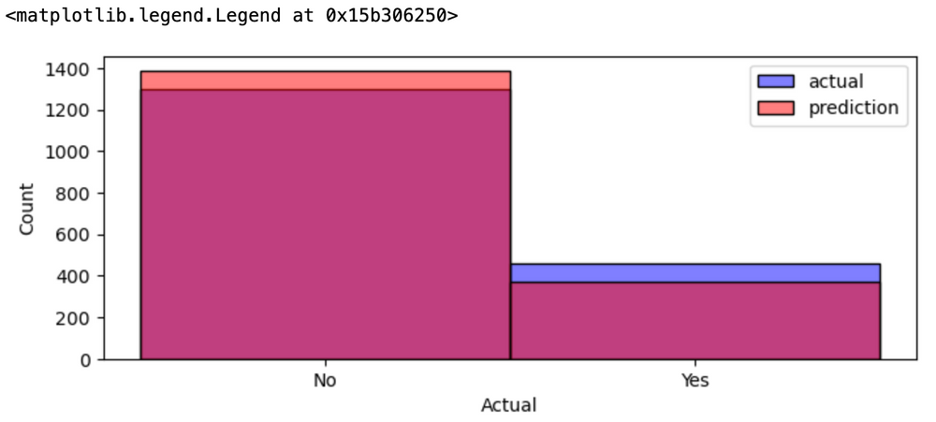
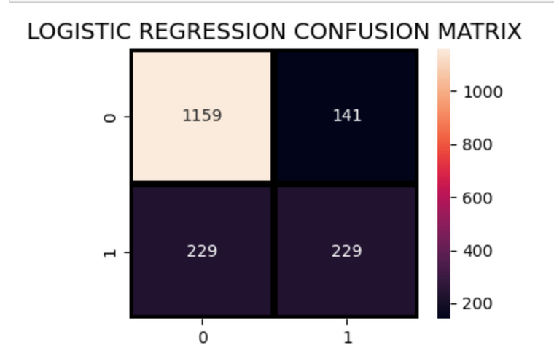
LOGISTIC REGRESSION
14

Slide 18
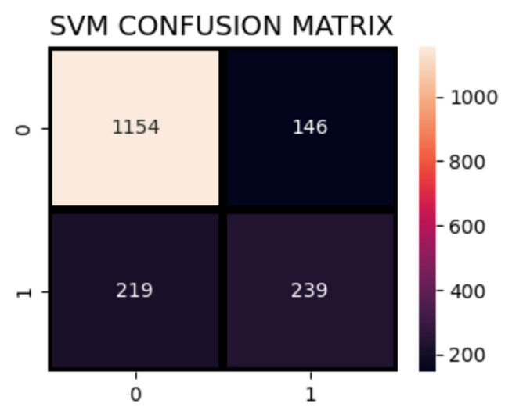
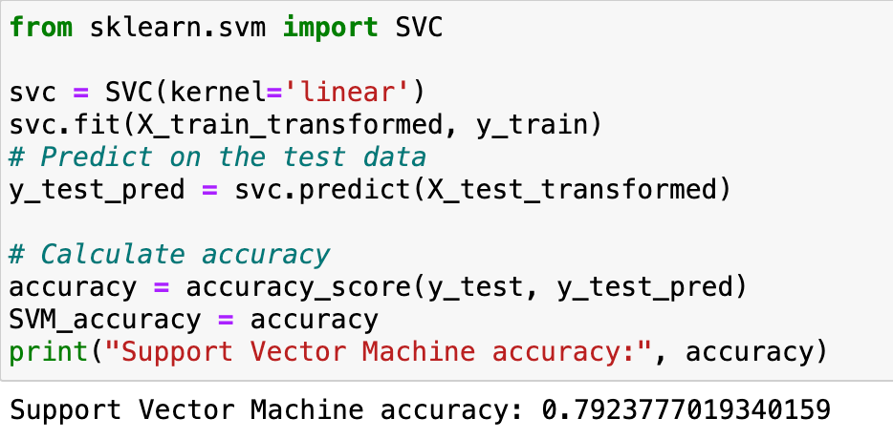
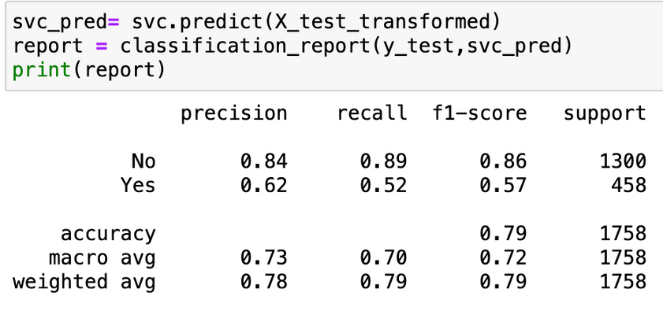
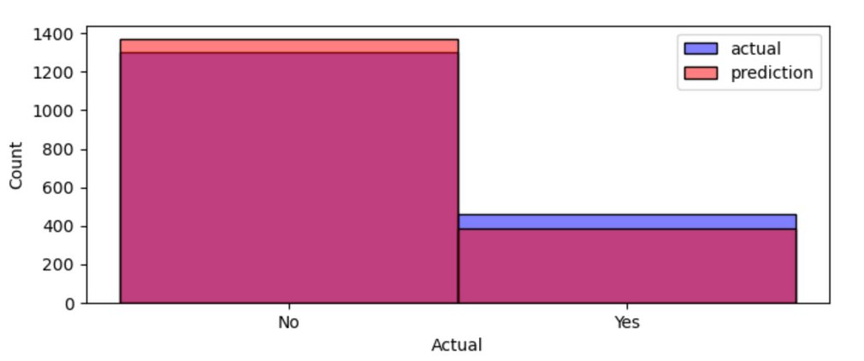
SUPPORT VECTOR MACHINE
15

Slide 19
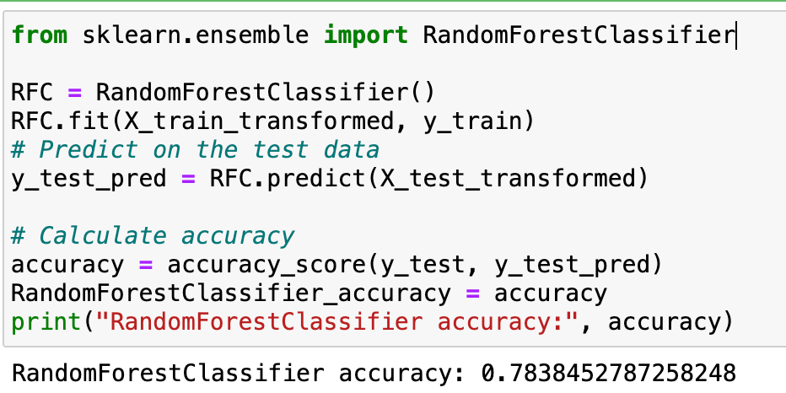
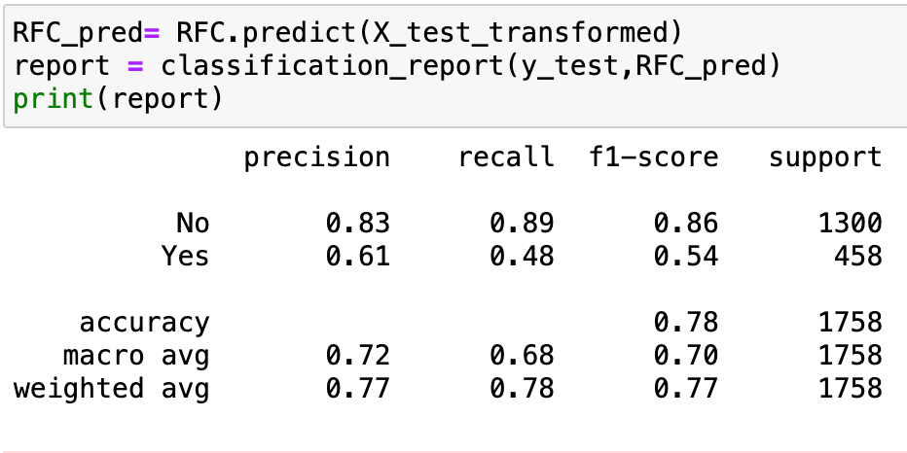
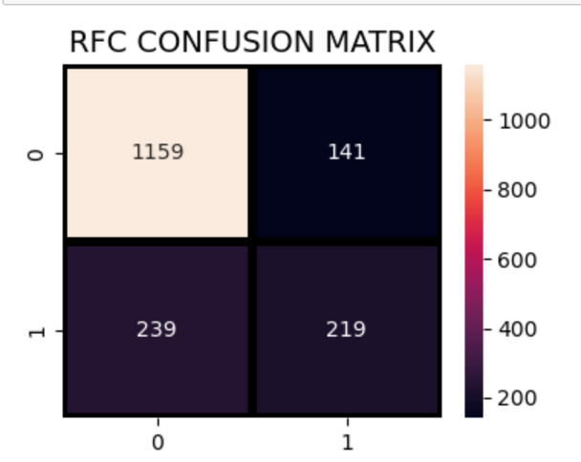
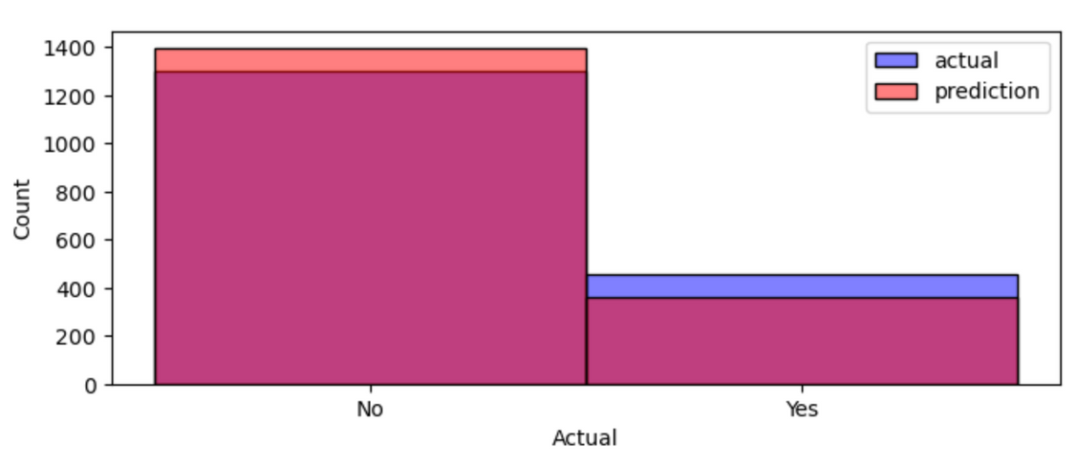
RANDOM FOREST CLASSIFIER
16

Slide 20
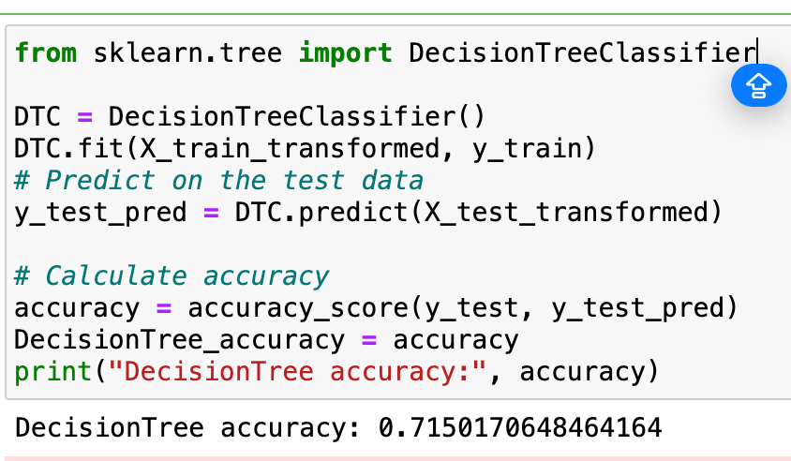
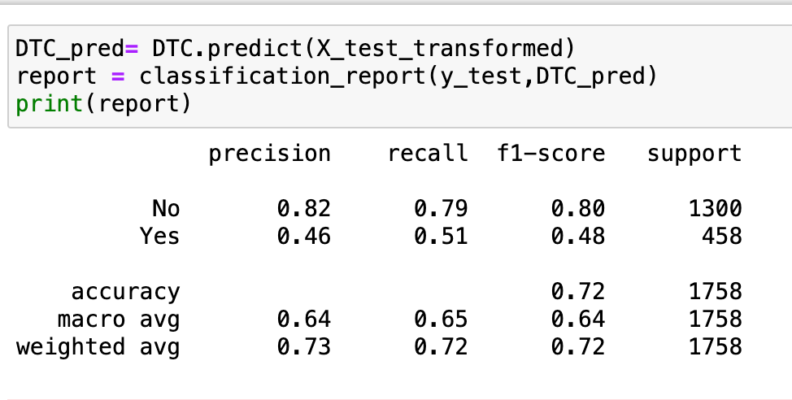
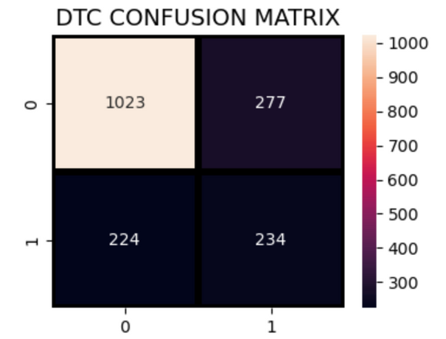
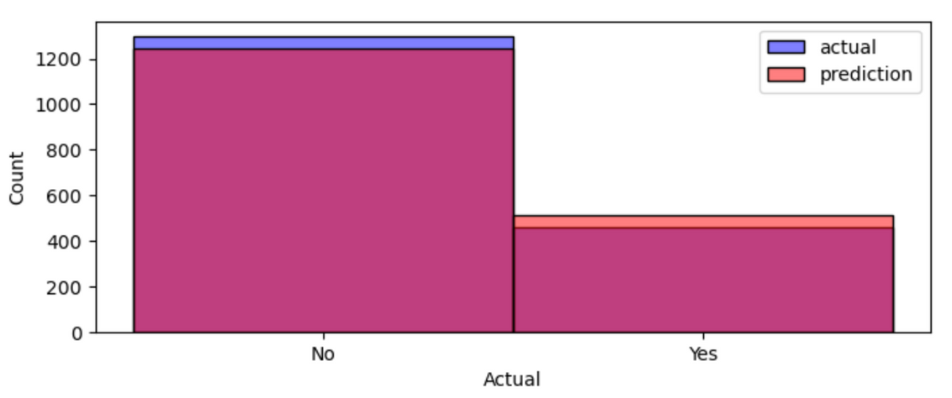
DECISION TREE CLASSIFIER
17

Slide 21
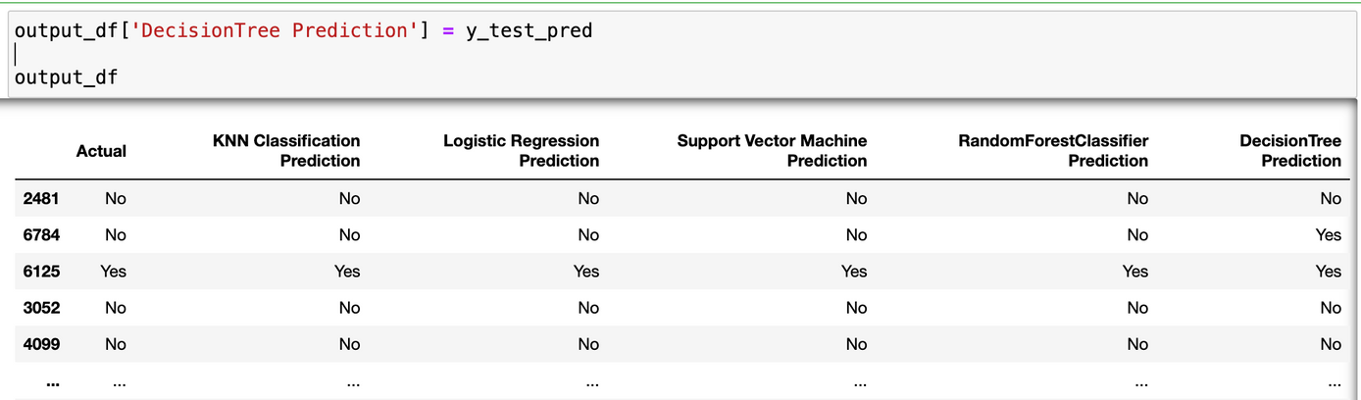
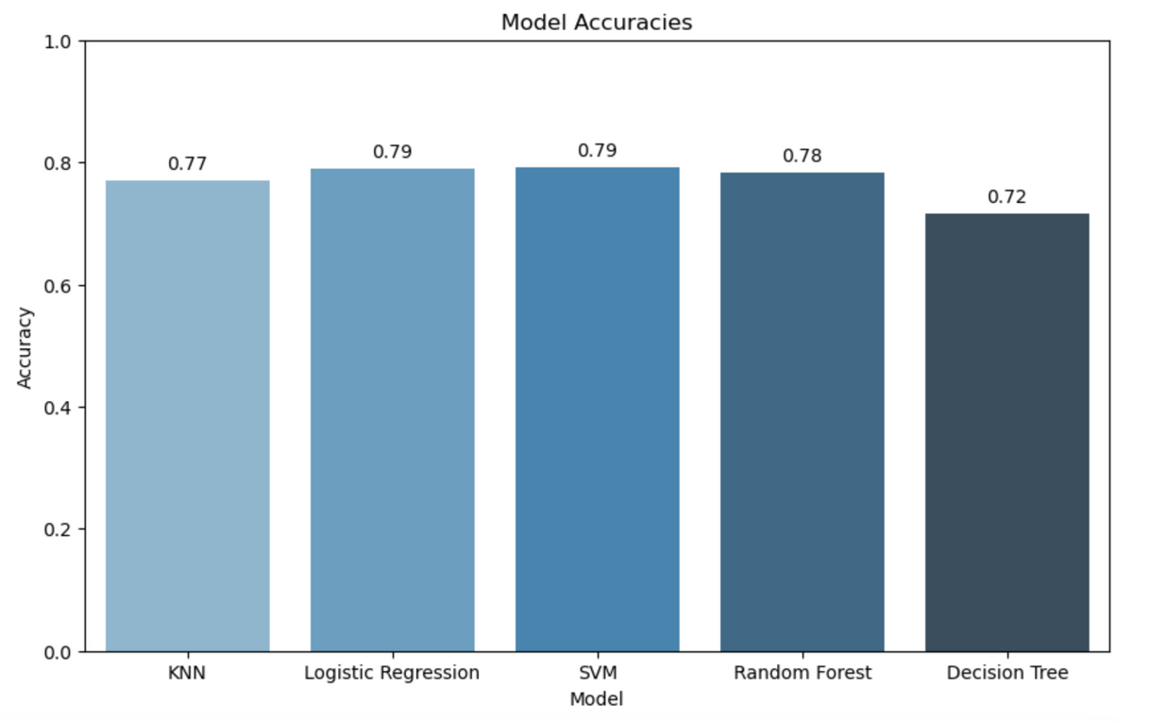
MODEL WITH ACCURACIES
Support Vector Machine and Logistic Regression are the best models with high accuracies with 79%
79%
78%
SVM & LR
Random Forest
77%
72%
KNN
Decision Tree
18

Slide 22
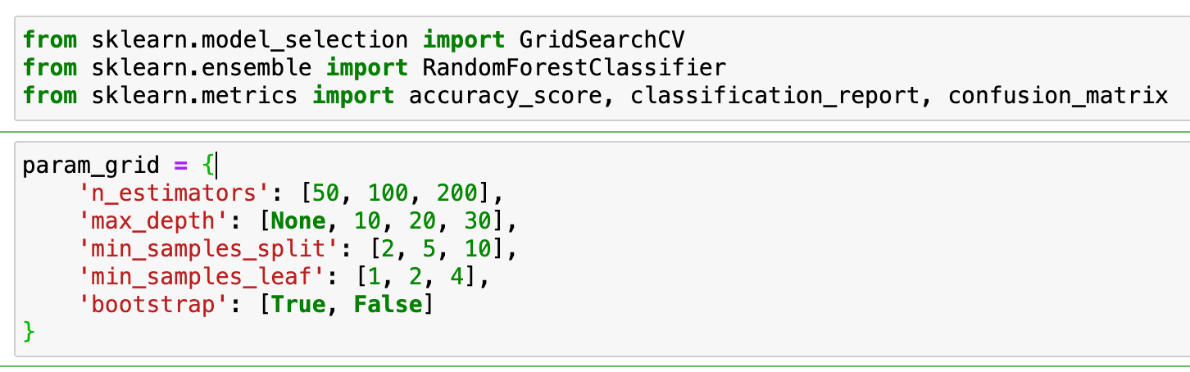
HYPERPARAMETER TUNING AND K-FOLD VALIDATION
Hyperparameter Tuning
Description: The process of optimizing the parameters of a model to improve its performance.
Techniques Used: Grid Search, Random Search.
Outcome: Identified the best combination of parameters to maximize model accuracy.
K-Fold Validation
Description: A robust technique to evaluate model performance by dividing the dataset into K subsets.
Process:
The model is trained on K-1 subsets and tested on the remaining subset.
This process is repeated K times, with each subset used exactly once as the test set.
Benefits: Ensures every observation in the dataset is used for both training and testing, providing a better estimation of model performance.
19

Slide 23
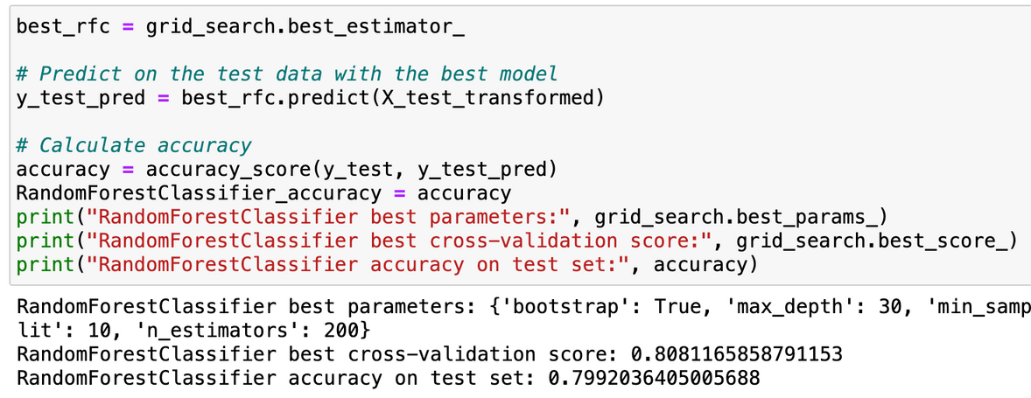



GRID SEARCH CV
20

Slide 24




RANDOMIZED SEARCH CV
21

Slide 25

CONCLUSION
Effective Models: Several models performed well in predicting customer churn:
Random Forest Classifier:
Cross-Validation Score: Achieved a strong average accuracy of 80.57% during K-Fold validation.
Test Set Accuracy: Demonstrated a reliable accuracy of 80.14% on the test set.
Support Vector Machine (SVM) and Logistic Regression (LR):
Both achieved an accuracy of around 79% on the test set.
Key Insights:
Data Preparation: Proper handling of missing values, encoding of categorical variables, and standardization of numerical features were crucial for model performance.
Feature Importance: Analyzing feature importance helped in understanding the key factors influencing customer churn.
Model Evaluation: Cross-validation and hyperparameter tuning ensured the model's robustness and generalizability.
Olivia Wilson
CEO & Founder
Marketing Head
22

Slide 26




THANK YOU!
https://www.linkedin.com/in/nithya21966/

